Slide 1
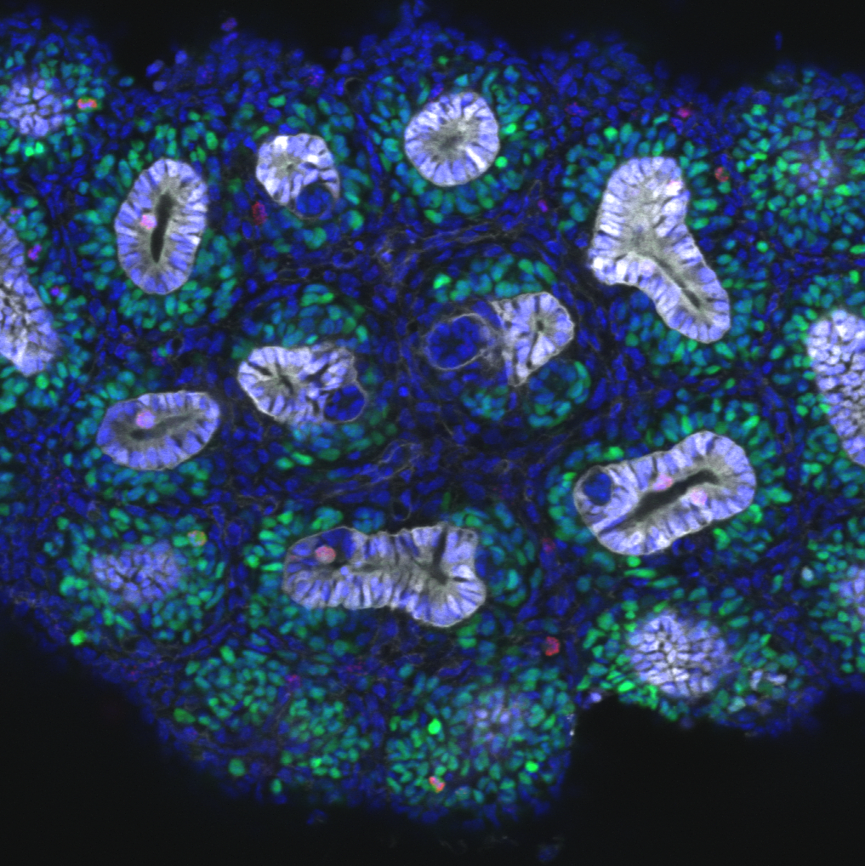
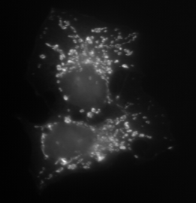
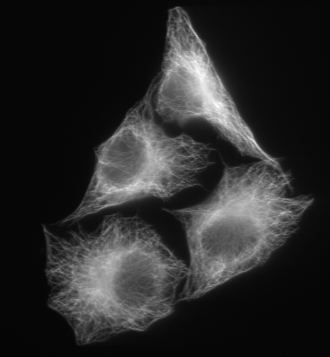
Datasets and slides: https://github.com/doktor-nick/intro-to-ml-for-imaging
Introduction to Machine Learning for Imaging
Dr Nick Hamilton
Institute Bio-Mathematician
Institute for Molecular Bioscience
Research Computing Centre
Queensland Cyber Infrastructure Foundation
n.hamilton@imb.uq.edu.au
www.imb.uq.edu.au
Power corrupts.
PowerPoint corrupts absolutely.
- Edward Tufte
Images: Groups Little & Teasdale
© Dr Nick 2021

Slide 2
Outline
Types of machine learning: supervised, unsupervised, reinforcement
Support Vector Machine
Classifying Images
Image Segmentation: classifying pixels in an image
Trainable Weka image segmentation in ImageJ/Fiji

Slide 3
What is machine learning?
Machine learning is a subset of Artificial Intelligence that uses statistical techniques to “learn” to computationally solve a problem without explicit programming
Types of Machine Learning Algorithms
Neural Networks, Support Vector Machines, Bayesian Networks, Genetic Algorithms, …
Why now?
Deep learning : Neural Networks with many connected “layers”
Convolution Neural Networks – inspired by organization of visual cortex
GPUs make training the “deep” networks feasible
“Easy” to frameworks such as Tensorflow, Torch, Theano, Fiji / Trainable Weka …
Peak hype!
Machine learning is far from perfect
The feature that the ML is using to classify may in fact be an artifact
Is often a black box with little insight into how it is working
Notes:
<number>

Slide 4
Types of machine learning
Supervised learning* (e.g. regression, classification)
You have examples of expected outputs for a set of inputs
For instance, a set of training images where each image contains either a hotdog or not a hotdog, and you know which is which
These are then used to train a machine learning method to classify images where you don’t know the answer already as either “hotdog” or “not a hotdog”
Unsupervised learning (e.g. clustering)
You don’t know the classes/types
You want the machine learning method to find the patterns for you and create classes
Reinforcement learning
Software agents receive stimulus from an environment and produce behaviours to maximise some cost function
For instance, playing Pacman to maximise the score

Slide 5
Example: (Linear) Support Vector Machines
Two or more classes of data point (potentially high dimensional)
During training on points of known type the SVM finds a line (hyperplane) that separates them and maximises margin between the classes
New data points are then classified accordingly
e.g. any coordinate pair (x,y)
?

Slide 6
Images and Machine Learning

Slide 7
Image Basics: Pixels
An image is made up of a rectangular array of dots called pixels
Each pixel has a value in the range 0 to 2^{n} -1 for some integer n
Typically, n might be 8, 16 or 24 (8 bit, 16 bit or 24 bit)
correspond to 0..255, 0..65535, 0..16777215
A bright pixel would have a high value, e.g. 255
A dark pixel would have a low value, e.g. 0
Colour is usually represented as triples of numbers.
For instance, in RGB format the triple (255,255,0) would represent maximum brightness Red and Green, with no Blue.
Most people would perceive this as yellow.

Slide 8
The Mathematics of Image Analysis
At its core, image analysis applies functions to matrices of numbers.
We denote the values (intensity) in row x, column y by I(x,y)
E.g. A brightness increase might be performed by the function
I’(x,y) = I(x,y) + 20
E.g. an object detector assigns individual objects a unique number
I’(x,y) = 255, if I(x,y) > 100
0, otherwise
29 | 27 | 17 | 24 | 20
24 | 99 | 134 | 71 | 13
21 | 148 | 157 | 134 | 11
21 | 31 | 31 | 14 | 42
49 | 47 | 37 | 44 | 40
44 | 119 | 154 | 91 | 33
41 | 168 | 177 | 154 | 31
41 | 51 | 51 | 34 | 62
0 | 0 | 0 | 0 | 0
0 | 0 | 255 | 0 | 0
0 | 255 | 255 | 255 | 0
0 | 0 | 0 | 0 | 0

Slide 9
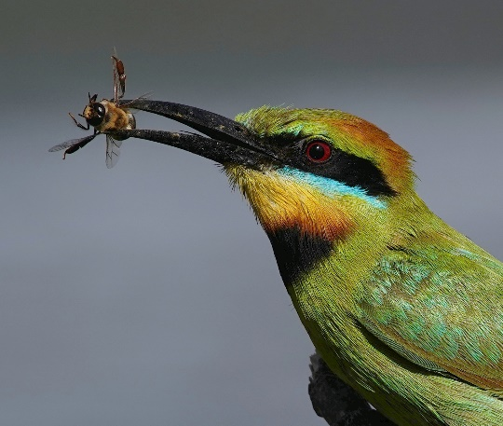
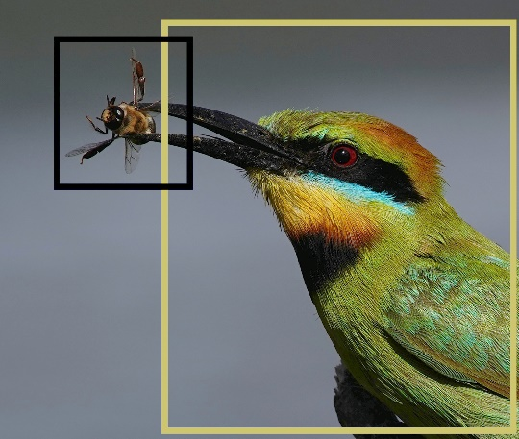
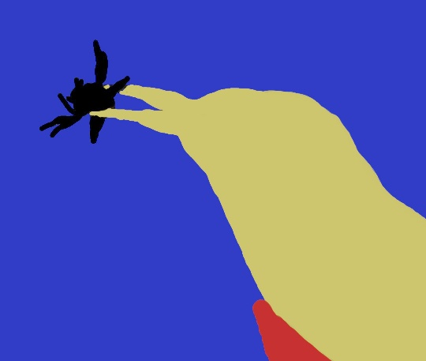
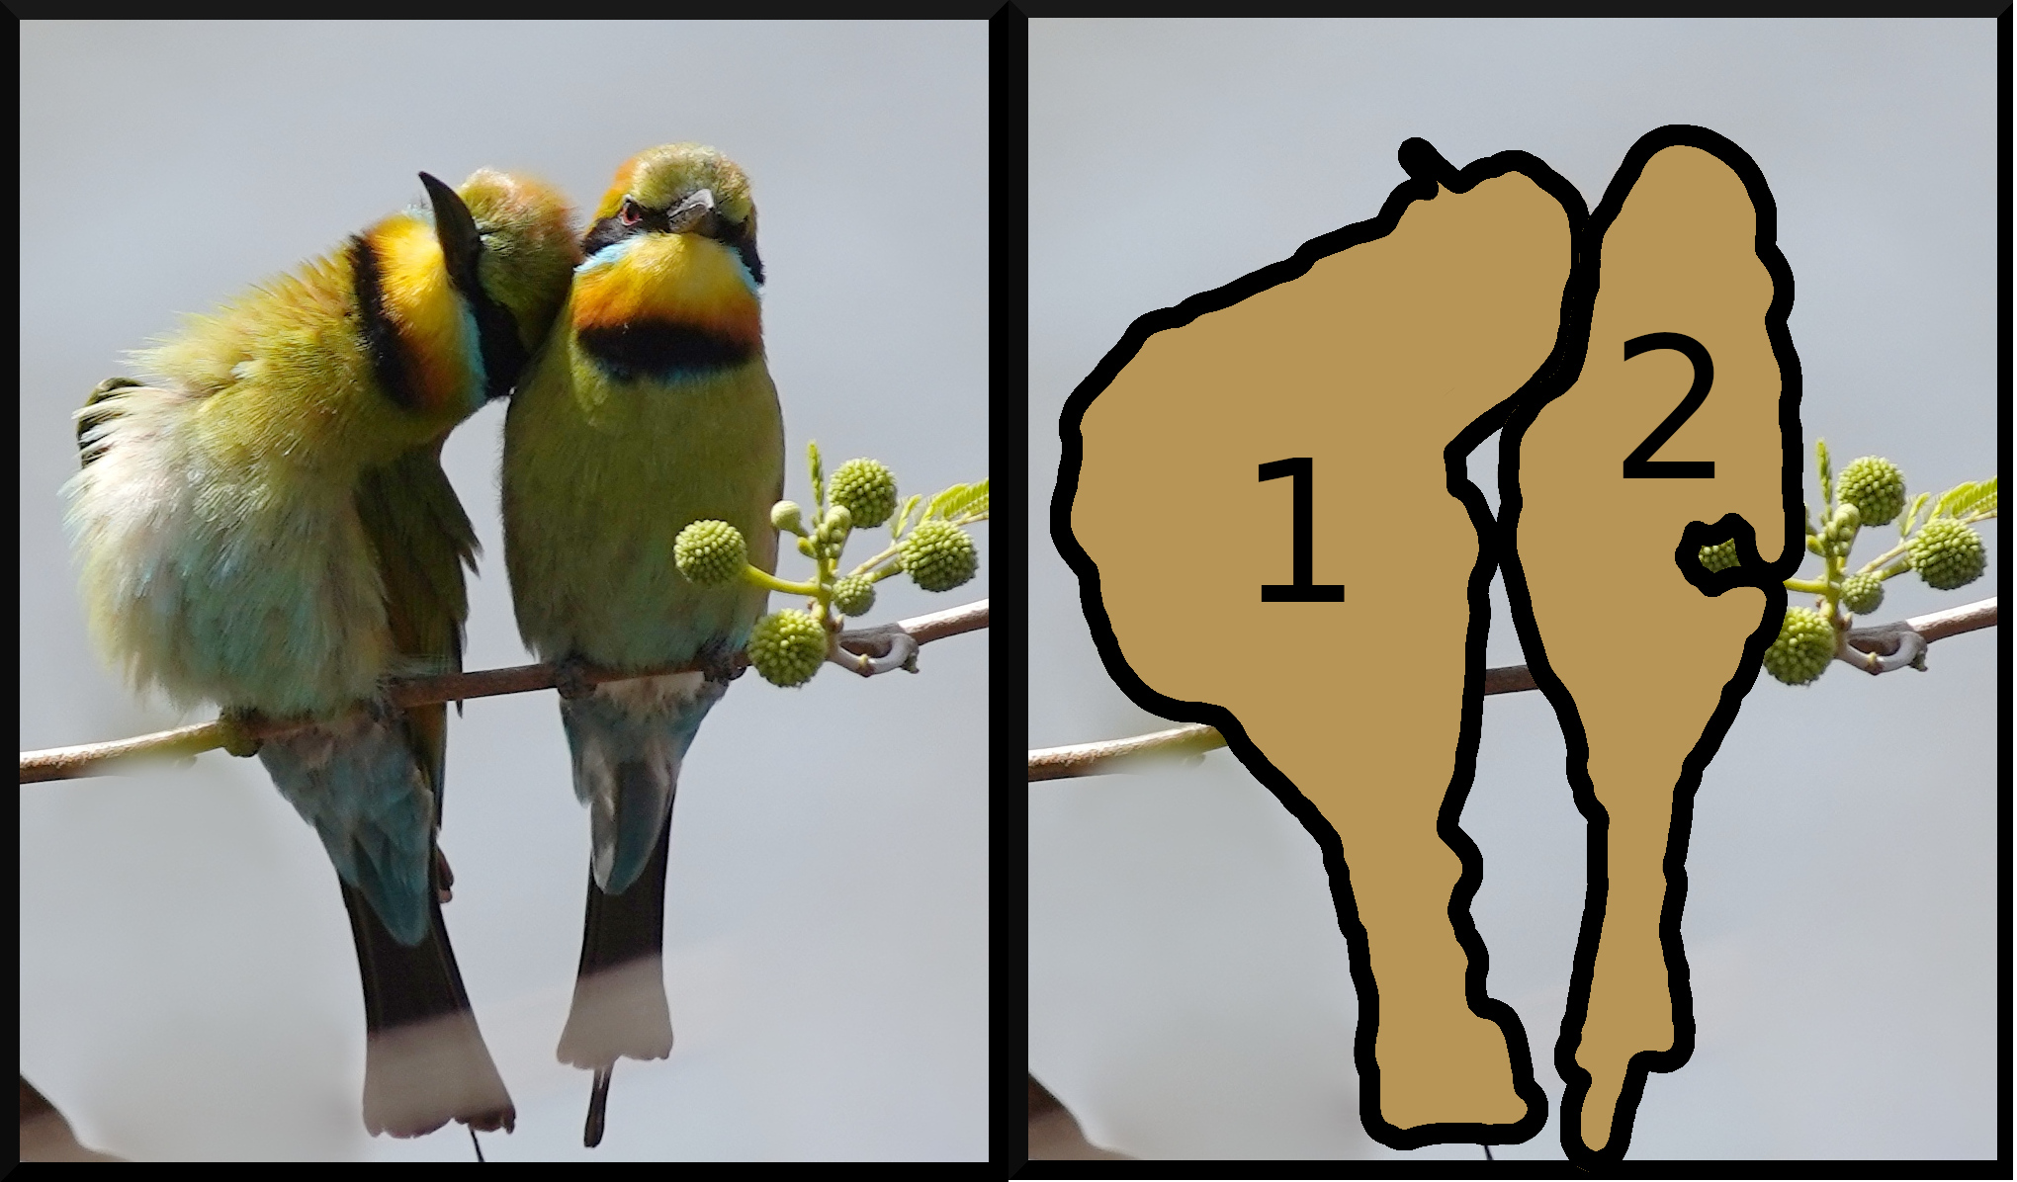
Applications of Computer Vision
Classification
Semantic Segmentation
Object Detection
Instance Segmentation
Rainbow bee-eater
Bee-eater, bee
Bee-eater, bee, stick,
background
Bee-eater 1 and 2

Slide 10
Outline of Image Classification using Machine Learning

Slide 11
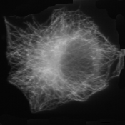
Image Classification
( 0.000772532, 0.00154506, 0.00343348, 0.0139056, 0.0308155,
0.0440343, 0.0337339, 0.0433476, 0.828412, 0.000235031,
0.000352547, 0.00205653, 0.00593454, 0.0223867, 0.0351372,
0.022093, 0.0312004, 0.880604, 0.000420663, 0.00117786,
0.00496382, 0.0165741, 0.058388, 0.107017, 0.0904425,
0.110803, 0.61024)
Cytoskeleton
=
=
Image Statistics
Generation
Machine learning
The key is to generate image statistics that distinguish the classes of imaging
Notes:
Stats: e.g. intensity, variance, edges, …
<number>

Slide 12
Image Classification
APPROACH
Two sets of images:
A training/test set for which the class of each image is known
A large number of images that you want to classify
Generate image statistics for each image
Train a machine learning technique such as a Support Vector Machine (SVM) or Neural Network (NN) to distinguish the classes on the training/test set
Use the trained SVM or NN to classify the other images
Have a coffee while the machine does all the work

Slide 13
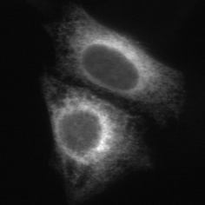

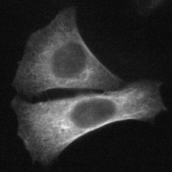
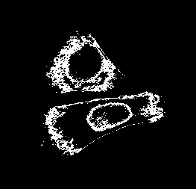
Threshold Adjacency Statistics
ER
Microtubules
Let µ be the mean intensity in the image
(Band pass) threshold intensity in range (µ, µ+30)
Hamilton, Pantelic, Hanson, Teasdale, BMC Bioinformatics 8:110
Notes:
<number>
Human eye only few tens of gray scale values. First image stats specifically designed for subcellular imaging.

Slide 14
Threshold Adjacency Statistics (TAS)
Count number “on” pixels with
0 on neighbours
1 on neighbour
…
8 on neighbours
}
Nine image statistics
Notes:
<number>
normalise

Slide 15
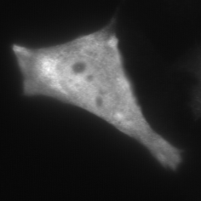
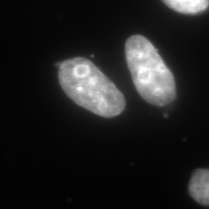
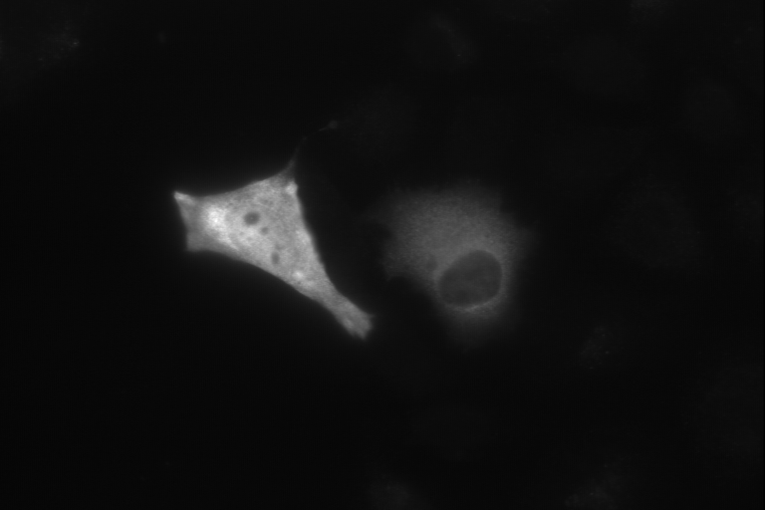
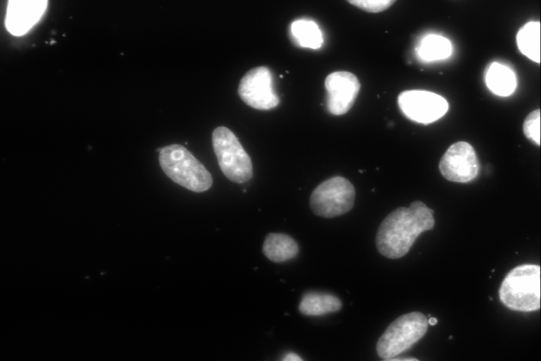


(Protein Cell) Image Classification - where is the protein in the cell
Mask/Crop/Select
Image Acquisition
Classify/Filter
Machine Learning
SVM
Image Statistics generation
120 10335 120 2920 100 7425 0121 20 …
Database/Web
Other Applications
Hamilton, Pantelic, Hanson, Teasdale, BMC Bioinformatics 2008
Notes:
<number>

Slide 16
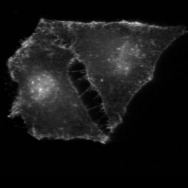
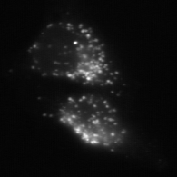
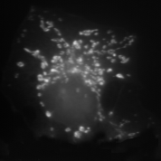
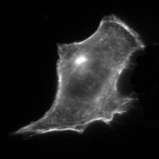
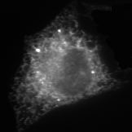
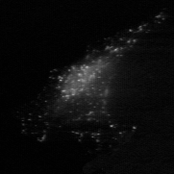
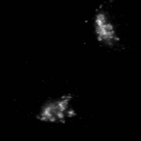
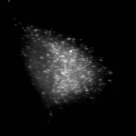
(Protein Cell) Image Classification
Micro-Cyto
PM
Lysosome
Mitochondria
Nucleus
Actin-Cyto
ER
Endosome
Golgi
Peroxisome
HeLa cells, fluorescent imaging, 60X
10 locations * 50 plate images/class = 500 plates
Up to 95% correctly classified using TAS image stats + SVM
CellProfiler now has facilities for machine classification of cell imaging
Hamilton, Pantelic, Hanson, Teasdale, BMC Bioinformatics 8:110
Notes:
<number>
Instead of 90 days and a burned out RA, could be done in about 3 hours on my laptop using TAS or 3 days using Haralick.
Approach seems good. Best published results. Novel stastistics. Leader in field.
Well fine, we can automatically classify, but a bit of a blunt tool.

Slide 17
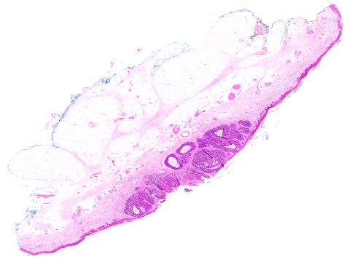
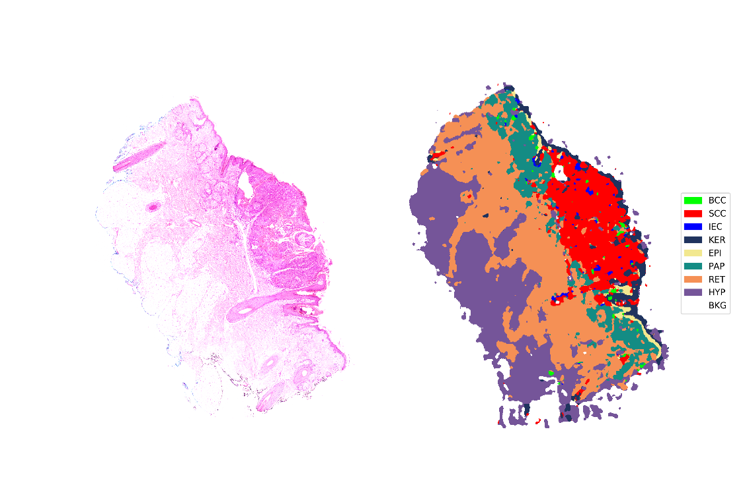
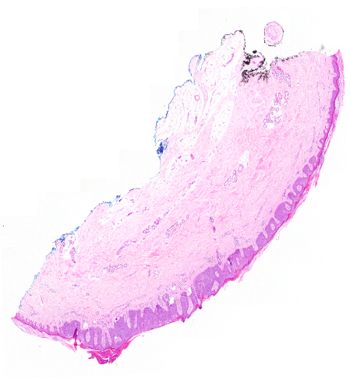
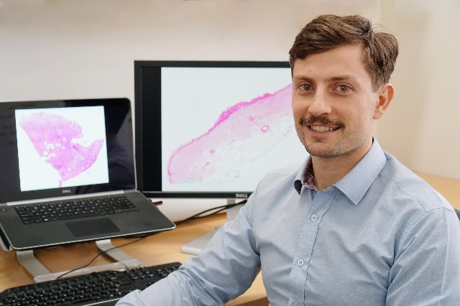
Non-Melanoma Skin Cancer Image Classification
Simon Thomas (2018) imaged
Basal Cell Carcinoma
284 Images
( x10 Magnification )
135 Excisions
91 Shave Biopsies
58 Punch Biopsies
of BCC, SCC, IEC, normal
that had been classified by an expert pathologist
Squamous Cell Carcinoma
99% accuracy training a
convolution neural network
Intraepidermal Carcinoma
Histology Imaging
Notes:
<number>

Slide 18
Image Segmentation and Machine Learning

Slide 19
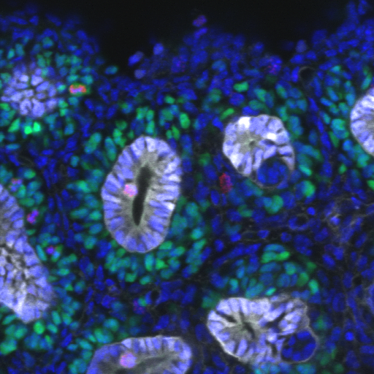
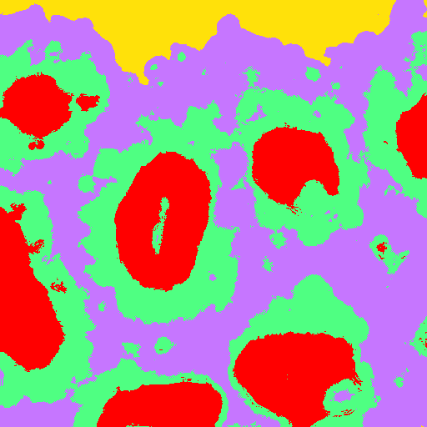
Image Segmentation and Machine Learning
Definition
A segmentation is a partition of an image into regions
e.g. foreground/background
Approach
Instead of a whole image we want to classify individual pixels
Ureteric tree
Cap mesenchyme
Stroma
Background
Image: Alex Combes / Melissa Little Lab
Notes:
<number>

Slide 20
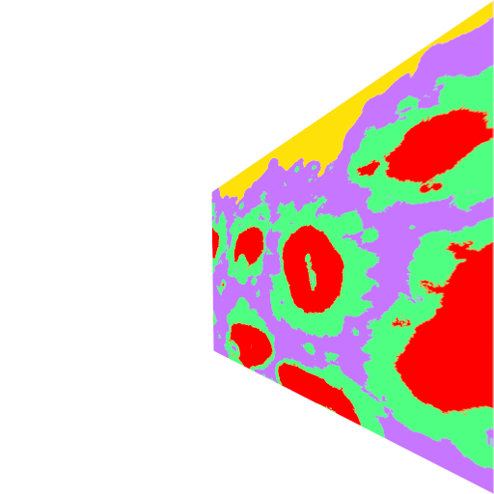
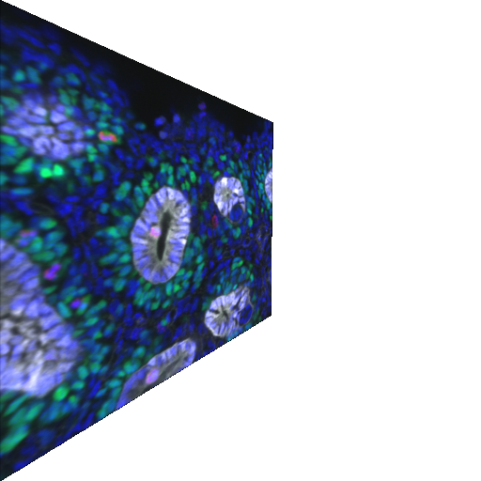
Image Segmentation and Machine Learning
Generate statistics for each pixel in the image
E.g. intensity, local median intensity, gradient, …
Classify that pixel using machine learning
(0.1,1.4,-1.5, 0.2, 2.3)
stats for
each pixel
classify

Slide 21
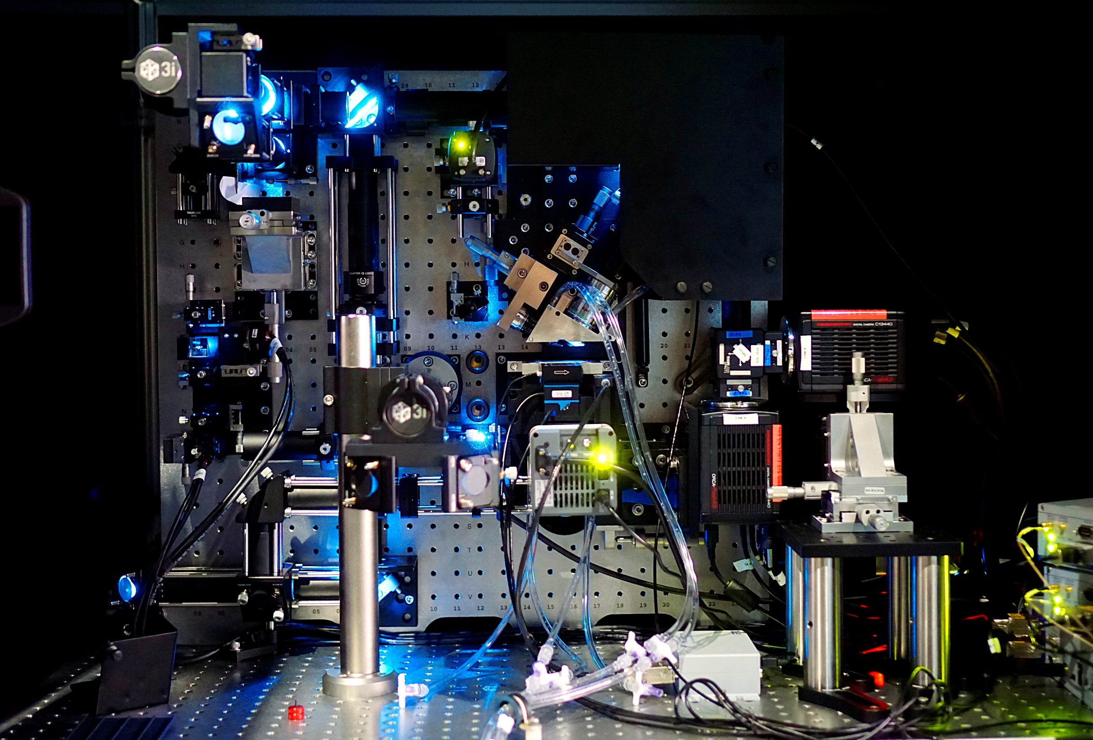
EXAMPLE: Lattice Light Sheet Microscope installed at IMB
Can generate up to 7 TB of image
data / day!
Notes:
<number>

Slide 22
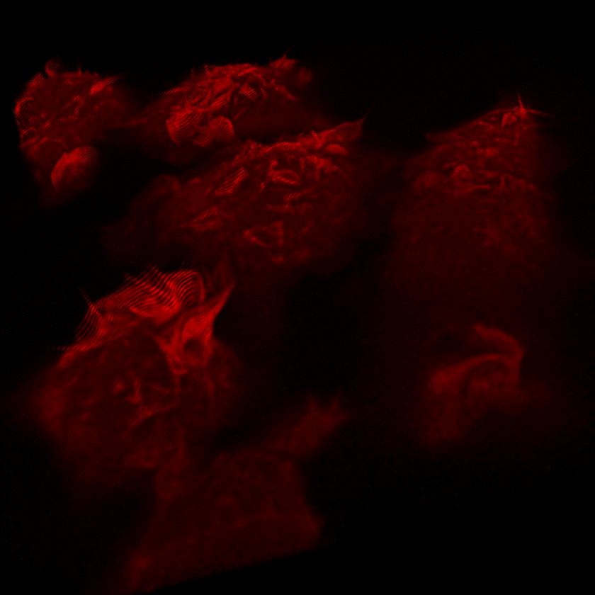
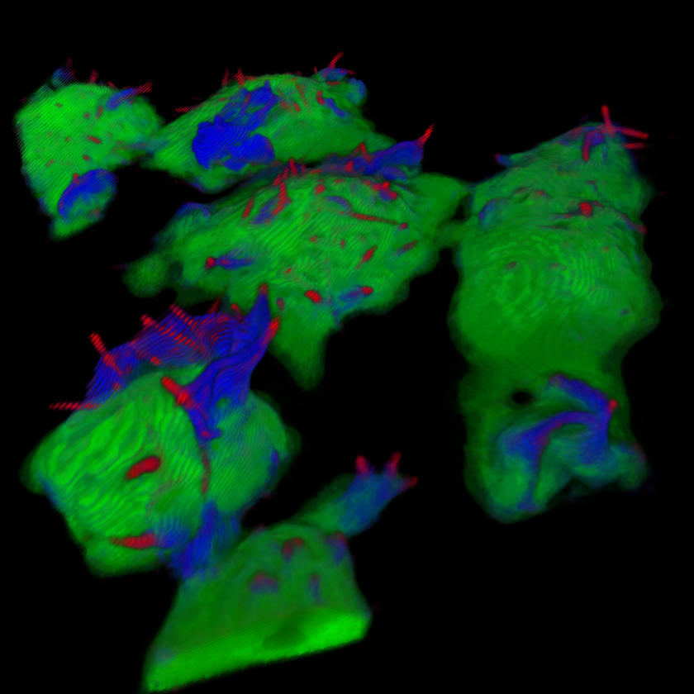
Segmentation of 3D LLSM imaging
Macrophage cells
(Image:Nick Condon / Stow Lab)
Segmentation into “tent poles” ,
ruffles, cell surface
(Image: James Lefevre / Hamilton Lab)
Notes:
<number>

Slide 23
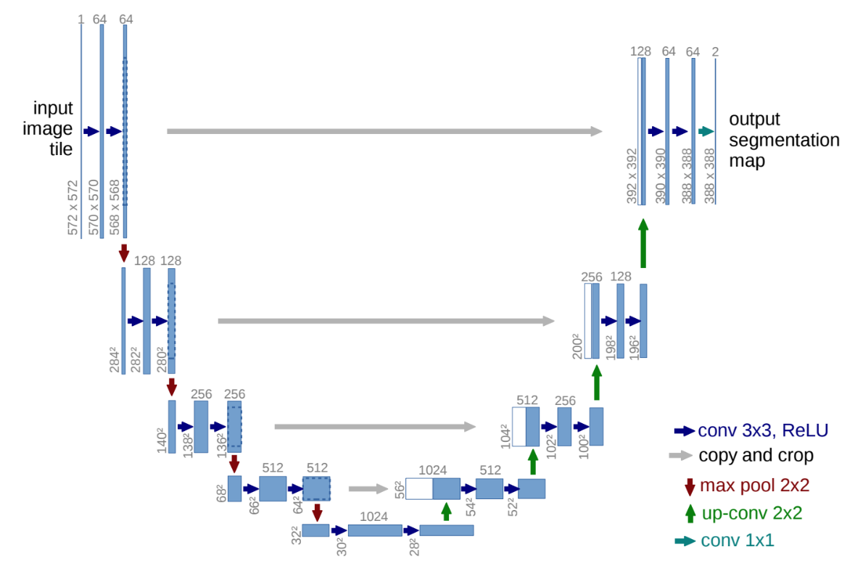
Another approach: convolutional deep learning with U-net
U-net was a new type of neural network architecture introduced in 2015
It down-scales then upscales an image to create a segmentation
It uses convolutions, max-pooling and skipping
U-Net and its variants are the state of the art in segmentation
Later in the year we will run advanced U-net workshop
U-net paper: https://arxiv.org/pdf/1505.04597.pdf

Slide 24
ImageJ and Trainable WEKA - pixel classification for segmentation

Slide 25
Trainable Weka in ImageJ/Fiji https://imagej.net/Trainable_Weka_Segmentation
ImageJ/Fiji is open source image analysis software widely used in biology and many other fields
Trainable Weka is a plugin for Fiji that provides a number of machine learning methods and image statistics generation to segment imaging
It builds upon Weka, a powerful and general machine learning environment
Users select example regions / classes in an image
These are used to train a machine learning model to predict the class of each pixel in an image
The model may then be applied to segment individual or whole directories of images
Works on grey or RGB images

Slide 26
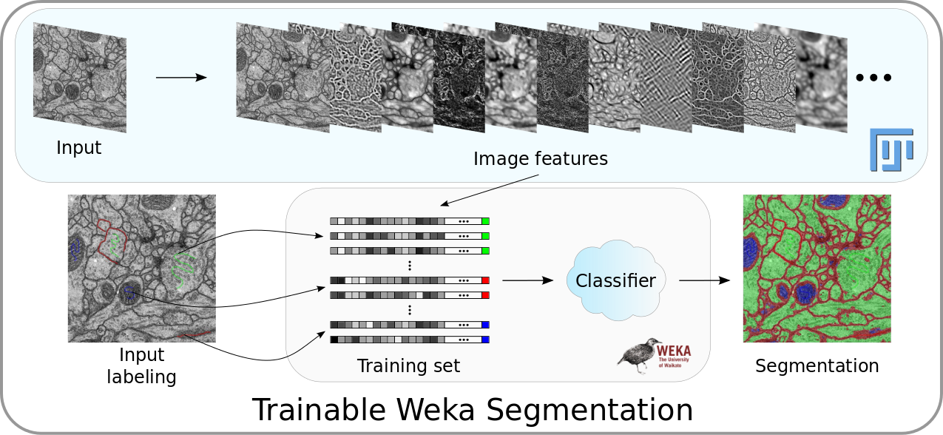
The Trainable Weka Pipeline
Image: https://imagej.net/Trainable_Weka_Segmentation

Slide 27
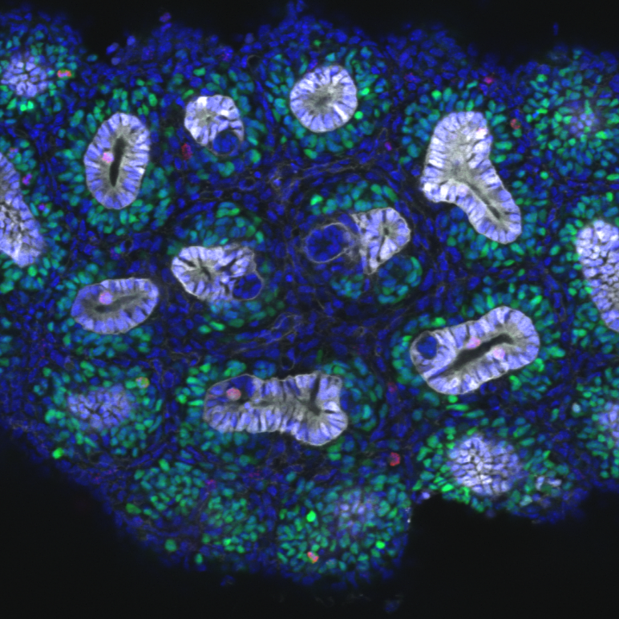
Demonstration of using Trainable Weka on a pretty kidney image
Image courtesy of Alex Combes / Little Lab

Slide 28
Trainable Weka Practical I Creating a simple 2D image segmenter and checking the results

Slide 29
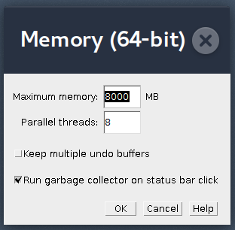
Before starting: marking sure you have enough memory available in Fiji
Trainable Weka and machine learning generally use a lot of memory
Almost every error you ever see will give some unreadable garbage which you have no idea what it means (this is my personal experience, anyway). It’s almost always memory
To increase memory in Fiji:
Go to Edit > Options > Memory and Threads
Select a “reasonable” amount of memory, e.g. on
a 16GB system, use, say 8GB
If you have a multi-core system set the parallel
threads parameter as well
Do click “Run garbage collector” as it cleans up
memory every time you click the status bar

Slide 30
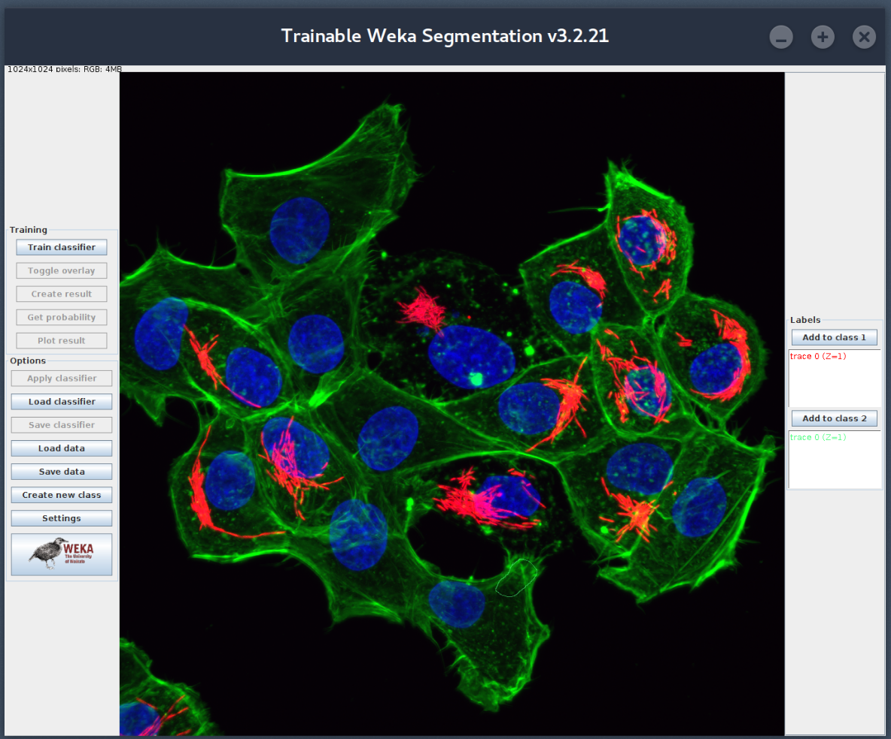
Getting Started with Trainable Weka (TW)
Open a Salmonella image in Fiji : File > Open
Start Trainable Weka : Plugins > Segmentation > Trainable Weka
Start training
Toggle showing
training results
Create
segmentation
}
Classes of points
Add a new class
of points
Settings
- Learning method
- Statistics
Zoom in/out: Ctrl + scroll or Crtl +/-
Image courtesy Dr Markus Kerr / Teasdale Lab
Notes:
<number>

Slide 31
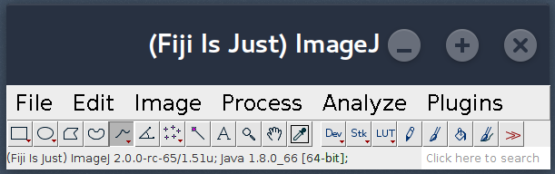
Selecting areas /classes and creating a classifier
Regions can be selected using the
Fiji selection tools
{
Selection tools
In the TW window, create new classes “nucleus” and “background” (the 2 classes
that are already there can be “salmonella” and “cell”)
On the image, select some points of classes salmonella, cell, nucleus,
background and add them to their respective classes
Click Train Classifier to start the training
Observe the results
Click Toggle overlay to compare the segmentation against the original image
Notes:
Can delete selection by double clicking it
<number>

Slide 32
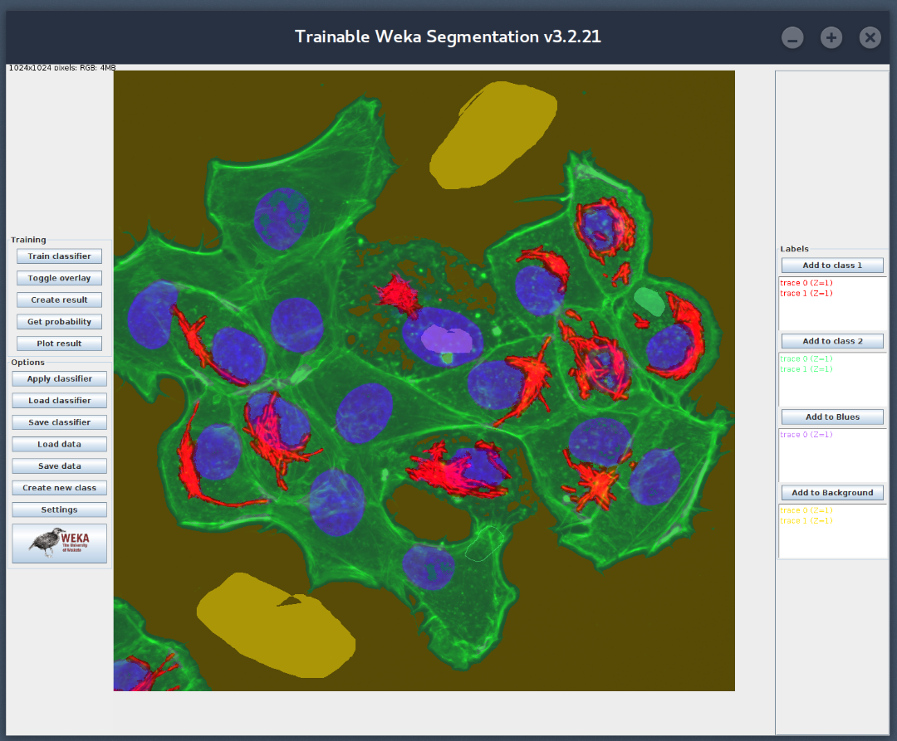
Fixing and retraining the classifier
Some areas will probably be misclassified. For instance in this image, some of the nucleus is classified as cell membrane
Select some of these areas and add them to the correct class
Train the classifier again and observe the results
Repeat until you are happy with the results
Use Create result to get a final segmentation

Slide 33
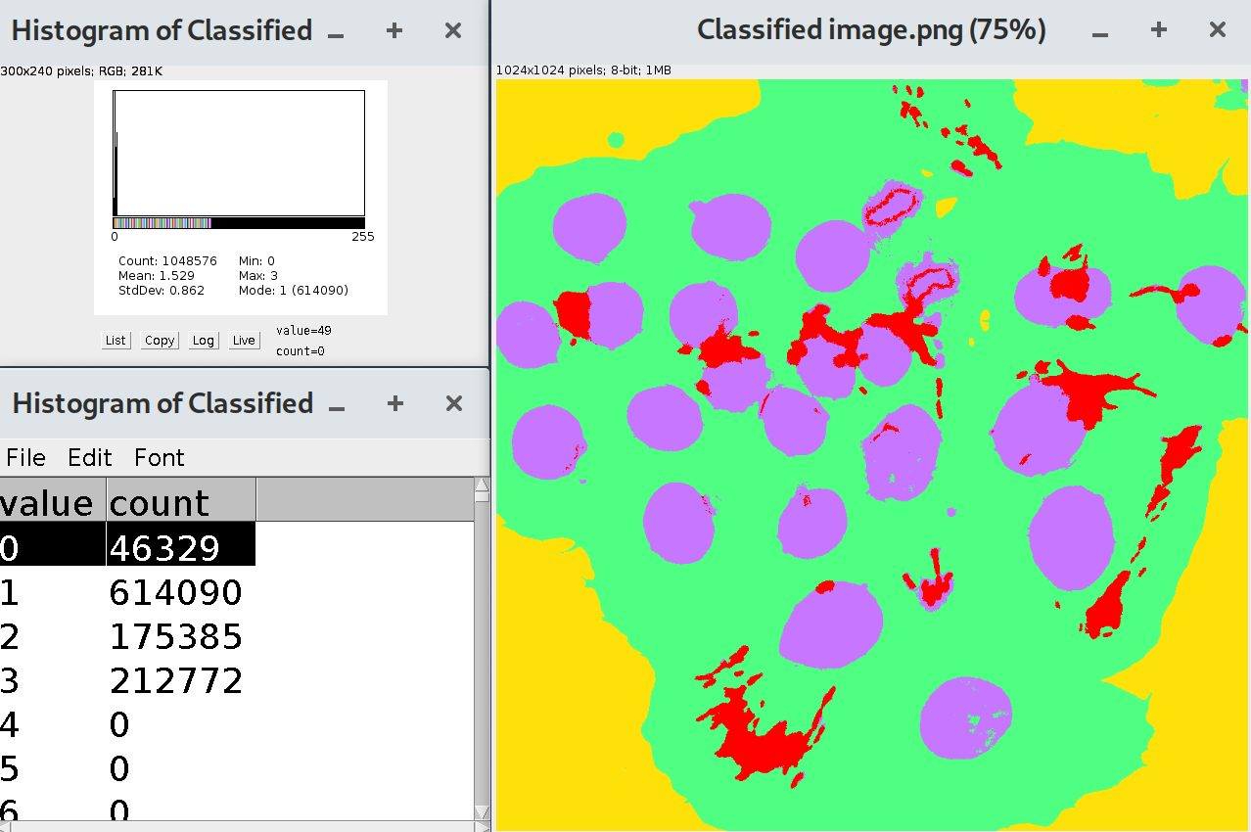
Counting the area of each region
In many cases you will want to know the area of each region type in the segmentation.
To do this, select the Classified
Image window, and on the Fiji menu select
Analyse > Histogram
On the Histogram window
click list.
A table listing the number of pixels for each of the labeled regions is then created. The order of the list is the same as for the class labels in the Trainable Weka interface.
Note: The numbers in the table are in pixels and you may want to convert these to an area, depending on the resolution of your imaging.

Slide 34
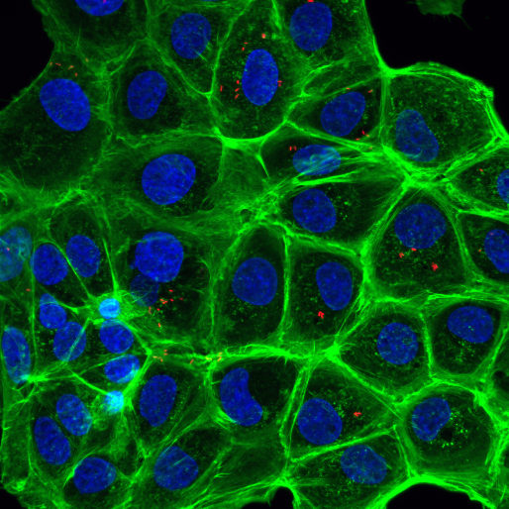
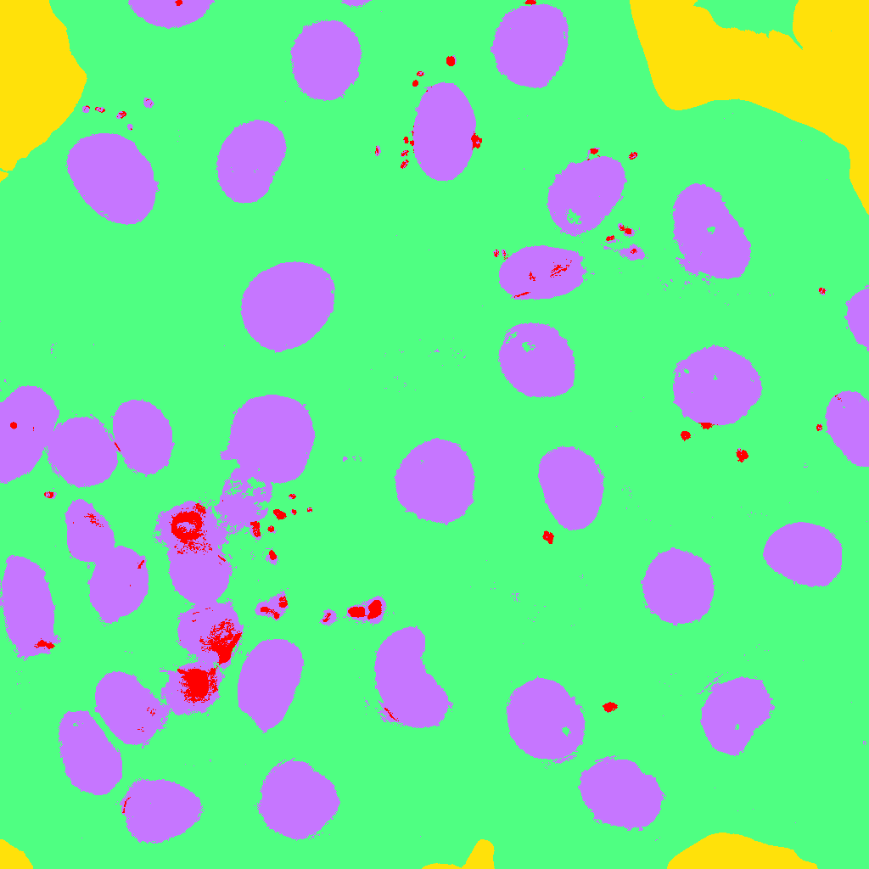
Applying your classifier to other images
1. Click Apply classifier and select a single image from
the Salmonella folder
(select “no” to probability map, when asked)
How do the results look? Is the classifier generalising?
2. Click Apply classifier and select all the images from
the Salmonella folder. Create a new folder when asked
to put the results images in
(select “no” to probability map, when asked)
3. Open each source image and its segmentation & compare
How do the results look? Is the classifier generalising?

Slide 35
Trainable Weka Practical II A closer look at the image statistics classifier types and problems such as overfitting

Slide 36
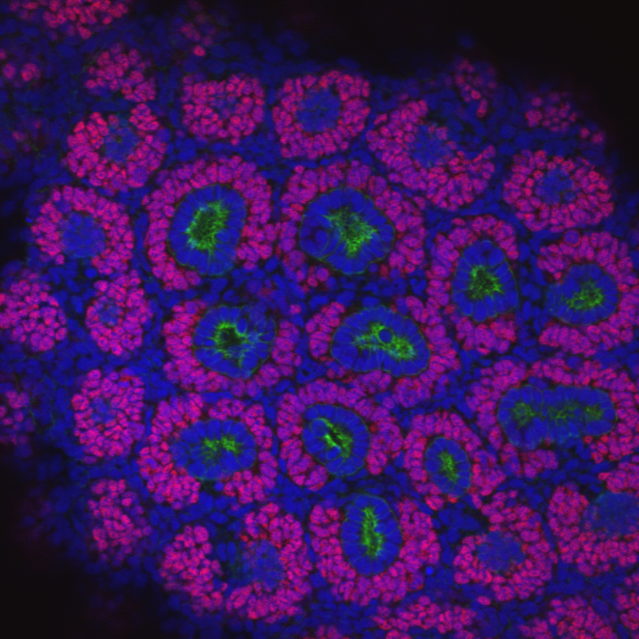
What do the image statistics look like?
cap mesenchyme
background
1. Open the 2D kidney image and start Trainable Weka
2. Create a classifier to distinguish the five classes of points shown in the image here
Note: a “fat” line also defines a set of points.
Line width can be set by double clicking the line tool
3. Save the Feature Stack to disk:
- In TW click Settings
- Click Save Feature Stack and save it to a
location on your computers disk
4. Drag the Feature Stack file from disk onto Fiji to open it
ureteric tree
stroma
lumin
Image courtesy Dr Alex Combes / Little Lab
Notes:
stroma
<number>

Slide 37
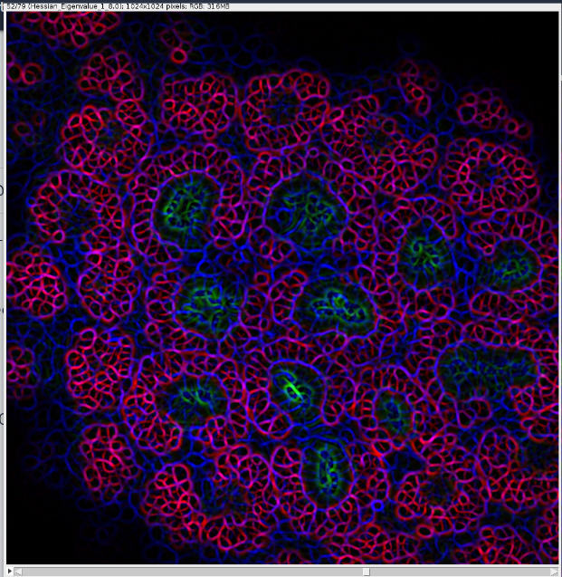
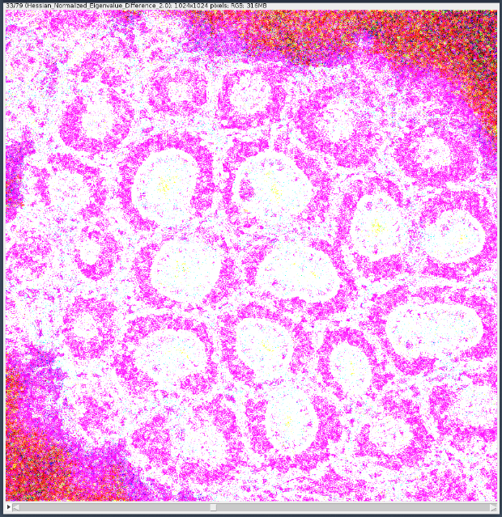
What do the image statistics look like?
This stack of images is image representations of the statistics that TW calculated for each pixel
The first image is the original image
The 78 other slices correspond to the 78 (default) statistics that TW calculates
Use the slider at the bottom of the image to move
through the stack
Each slice is labelled with the statistic and parameters
Can you see how certain statistics distinguish certain regions?
More information on the statistics calculated on TW site:
https://imagej.net/Trainable_Weka_Segmentation

Slide 38
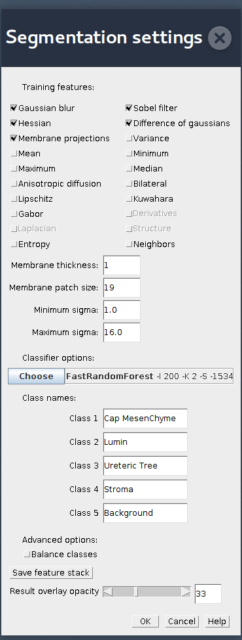
A closer look at the Image Statistics in TW
At the top are the currently selected statistics used for classification
More information on the statistics on the TW site:
https://imagej.net/Trainable_Weka_Segmentation
The Sobel filter, for instance, is an edge detector
Parameters to some of the statistics, such as what radius (sigma) to act over, are in the middle
The default sigmas range over 1, 2, 4, 8, 16
The larger sigma, the more computationally expensive it will be.
Some statistics are greyed out as they require the ImageScience library to be installed

Slide 39
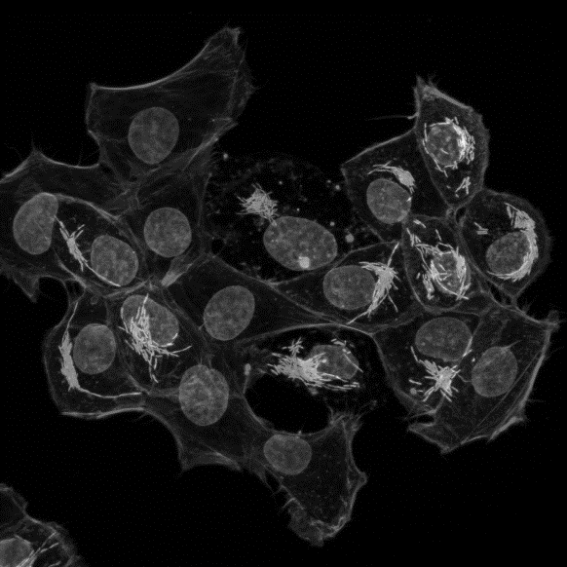
Trying other Image Statistics in TW
Open the Salmonella-BW image in TW
Create a classifier that distinguishes, nucleus, cell
membrane, salmonella, and background
Click Create Result so you have a reference to compare
Some things to try:
In Settings, select only Mean statistics, click ok and
then Train Classifier in the main TW window. How did it do?
In Settings, select Save Feature Stack and then drag the saved stack into Fiji and examine the slices. These are the images obtained by averaging each pixel with those around them at radii =1, 2, 4, 8 and 16 pixels
In Settings, try setting the maximum sigma (the averaging radius) to either 1, 2, 4, or 8, and run Train Classifier again. How did it do?
Try doing all of the above, but using the Sobel feature instead (remembering to set sigma to 16 initially)
It can be surprising how little information is needed for a reasonable classification
Sometimes statistics can be costly to calculate, but do not necessarily add much

Slide 40
Overfitting the data
Sometimes a machine learning model can fit the data it is trained on very well, but it fits so well that it does not generalise to other data sets. This is called overfitting.
For instance, the black line here
is a “classifier” that separates the
blue and red dots.
But it is questionable whether the
two types of dots are really
distinguishable.
Maybe the statistics do not properly
distinguish the classes we want to
distinguish.
In the next exercise we will create a crazy image segmenter, then see how well it generalises

Slide 41
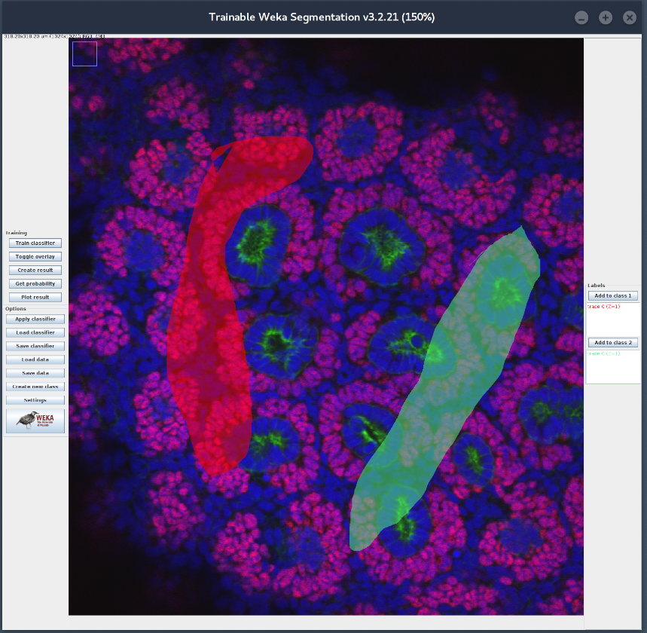
Creating a crazy classifier
Close your current Trainable Weka session, and open up the 2D kidney image again
Start TW again
Create a two class classifier with two regions
where it is clearly not possible to reasonably
distinguish them (see right), adding those
regions to distinct classes, then clicking
Train Classifier
How does it look? Click Toggle Overlay to see how well it has correctly classified points in
(a) the regions you selected?
(b) outside those regions?
It may be easier to see if you click Create Result to create the segmentation mask
Some methods of machine learning are more prone to overfitting that others
That is what we will look at next

Slide 42

Trying other machine learning methods
The default machine learning method in TW is called random forests
There are many other methods of machine learning available in TW
For instance, MultilayerPerceptron is what is often called
a Neural Network
Depending on your data, they may be more or less prone to overfit and not generalise well. They may also take more or
less time to train
In TW these may be selected in Settings > Choose

Slide 43
Trying other machine learning methods
Keeping the crazy classifier you created before, lets try some other learning methods.
Select Settings > Choose > MultilayerPerceptron and click OK
Click Train Classifier to create a classifier
After a while you will get bored waiting for it to finish: training Neural
Networks can be slow!
Click Stop to kill the Neural Network training
2. Instead select Settings > Choose > SGD and click OK
This is a type of Support Vector Machine, another popular training method.
Click Train Classifier to create a classifier
Look at the results, possibly using Create Results
Did this correctly classify the regions you defines as Class 1 and Class 2?
Does this look like overfitting? Is this better or worse than the (default)
Random Forests learning method?

Slide 44
Trainable Weka Practical III Moving into 3D
Notes:
<number>

Slide 45
3D segmentation in Trainable Weka
3D segmentation could be done in TW by segmenting each of the 2D slices individually
However, many structures in 3D would be difficult to distinguish only looking at 2D slices
Hence TW has several 3D image statistics that consider the 3 dimensional region around each pixel
For instance, the 3D mean or median intensity around a pixel
The interface for 3D segmentation in Trainable Weka is similar 2D, though there is now a slider under the image to select different slices

Slide 46

3D segmentation of kidney data
Load the 3D kidney dataset into Fiji and start
Trainable Weka 3D
We will create a classifier that distinguishes the cap
mesenchyme (pink), the rest of the kidney (blue), and
background (black regions)
Select a slice and add regions for each class. You will need to Create New Class so that you have 3 classes to use.
Click Train Classifier to begin the classification.
Use the slider under the image to look at the results. Fix any errors you see by selecting them, adding them to the correct class, and retraining the classfier.
Click Create Result to see the final segmentation. How did it do?
Save the feature stack (Settings > Save feature stack) and open the stack(s) in Fiji. Why are there multiple images?
You will notice that it takes a lot longer to both generate the statistics (because they are now 3D) and classify the images (because there are more of them).

Slide 47
Other things to try in Trainable Weka
Try TW on your own data!
Have a closer look at what each of the statistics TW uses does (see https://imagej.net/Trainable_Weka_Segmentation). For instance, membrane projections is interesting!
Get probability shows the probability each pixel is in each class rather than forcing it into a particular class.
Plot results gives a true positive / false positive ROC that gives an indication of how well the classifier is doing (hard to read!)
Balanced training. If a training set has many more examples of one class than another, this can bias it to performing better on classification. Try creating a unbalanced training set and testing the performance of the classifier. TW has
Setting > Balance Classes
to avoid this problem by resampling

Slide 48
Other things to try in Trainable Weka
For power users:
Data can be exported from Trainable Weka into Weka to provide an enhanced training and analysis environment
The Weka button in the bottom left corner starts this environment
There is an API for programming TW directly in Fiji using the macro language. See https://imagej.net/Trainable_Weka_Segmentation

